Slide 1
Revision
Chapters 5,6,7,8,12, XML and Pasrsers

Slide 2
Steps to create a Listener
1- Create a listener class
2- Put the class in the WEB-INF/classes
3- Put <listener> element in the web.xml Deployment Descriptor

Slide 3
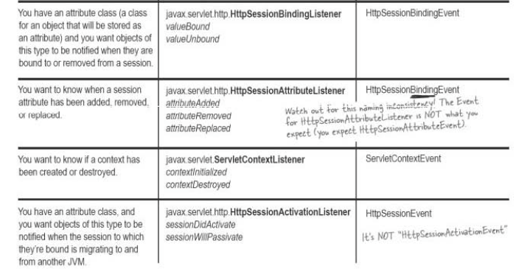
Types of Listener

Slide 4
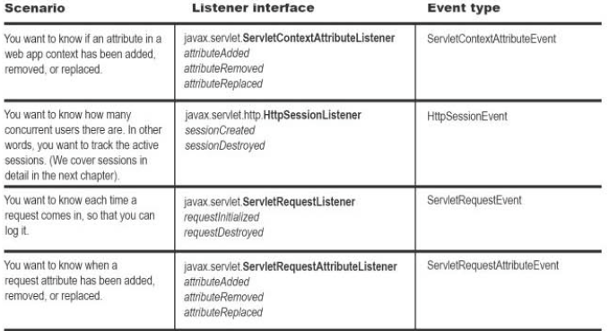
Types of Listener

Slide 5
Attribute
An Attribute is an object set into one of three other servlet API objects; which are:
1-ServletContext
2-HttpServletRequest
3-HttpSession

Slide 6
RequestDispatcher
We can get a RequestDispatcher from the following two objects:
1-Context
2-Request.
RequestDispatcher has the following two methods:
1- forward()
2- include()

Slide 7
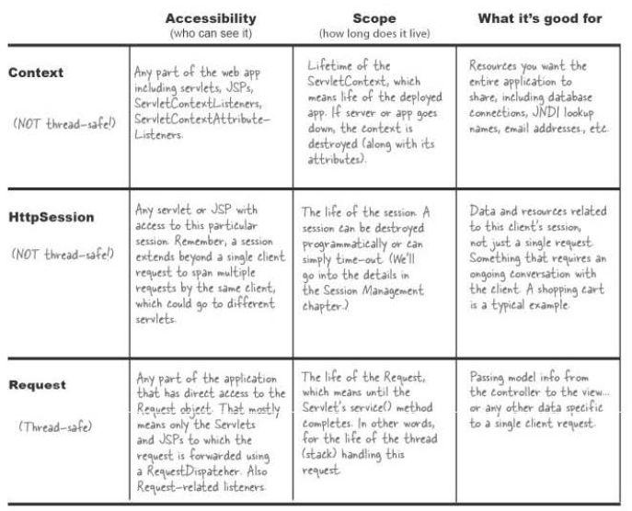

Slide 8
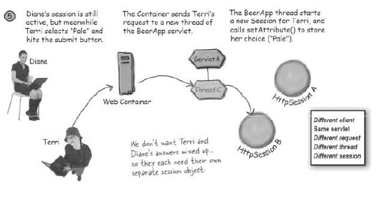
How Does a Session Object know which User it belongs to?

Slide 9
Session Migration.
Only HtpSession objects and their attributes move from one VM to another.
One ServletContext, per JVM
One ServletConfig per JVM.

Slide 10
What is a JSP?
JavaServer Pages (JSP) is a technology that helps software developers create dynamically generated web pages based on HTML,XML, or other document types.
JSP is Java code inside an HTML page.
The JSP file is translated into .java file. Then the .java file is compiled into a servlet class file.

Slide 11
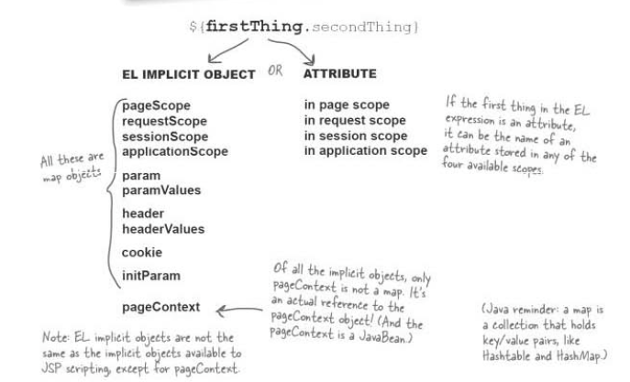
Understanding EL variable.

Slide 12
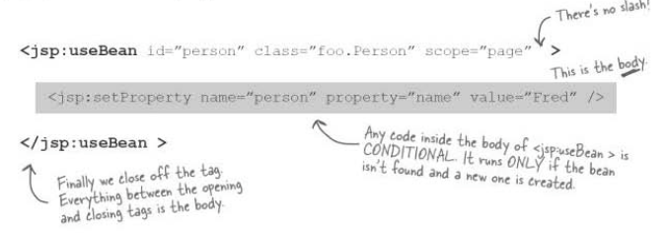
Setting a value using JSP Bean.

Slide 13
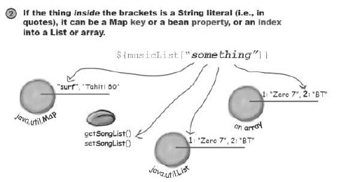
The [] operator

Slide 14
Steps to Using DOM
Following are the steps used while parsing a document using DOM Parser.
Import XML-related packages.
Create a DocumentBuilder
Create a Document from a file or stream
Extract the root element
Examine attributes
Examine sub-elements

Slide 15
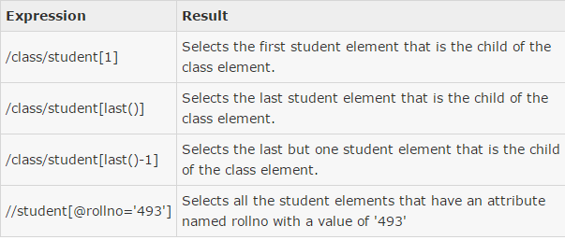
XPath Predicates

Slide 16
Web Security
Authentication
Authorization
Confidentiality
Data Integrity.

Slide 17
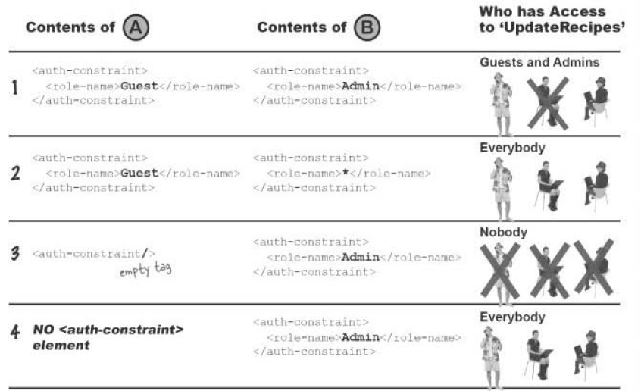
Security by configuration

